Slide 1
Project Title
UE20CS302 – Machine Intelligence
Mini Project
Project Title :AUTOMATIC ATTENDANCE MONITORING SYSTEM
Team No:
Project Guide : Prof. PREETHI P
Project Team with SRNs : PES1UG20CS138 PES1UG20CS155 PES1UG20CS126

Slide 2
Problem Statement
We are living in the 21st century which is the era of modern technology. Many traditional problems are being solved using new innovative technologies. Taking attendance daily is an indispensable part of educational institutions as well as offices. An automatic attendance system is one that keeps track of individuals’ attendance. Recording the daily attendance of individuals in all educational institutions is a major concern. In the traditional attendance system, a person has to check one by one if someone is absent or not. It is both exhausting and time-consuming . Manual ways are prone to errors due to the sheer number of individuals, their in/out timings, leaves, absences etc. On the other hand, automated systems ensure accurate payroll data . Biometric attendance systems through voice, iris, and fingerprint recognition require complex and expensive hardware support. An auto attendance system using face recognition, which is another biometric trait, can resolve all these problems In this work, we have developed a biometric artificial intelligence (AI) based system that will be advantageous in educational/official sectors where regular attendance is greatly needed.
Notes:
Provide a basic introduction of the project and also an overview of scope it entails.
Set the context.

Slide 3
Application and Uses
1)Primary application being used in classroom to take the attendance of the students.
2)It is mainly used to decrease the false attendance .
3)Security/counterterrorism: Access control, comparing surveillance images to know terrorist
4)ATM: The software is quickly able to verify a customers face.
5)Healthcare :Minimize fraud by identifying identities
6)Industry: It is used in industry for monitoring the employees .
Notes:
Provide a basic introduction of the project and also an overview of scope it entails.
Set the context.

Slide 4
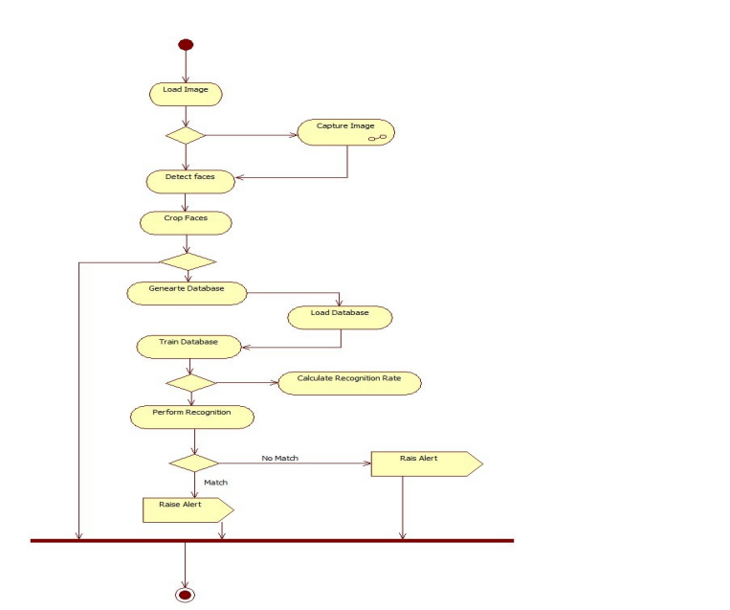
High level Architecture

Slide 5
Literature Survey
Title of the paper | Year of Publication | Journal/Conference Name | Advantages | Limitations
A Review of Student Attendance System Using Near-Field Communication (NFC) Technology | June 2015 | International Conference on Computational Science and Its Applications | Using Near-Field Communication (NFC) technology to improve manual attendance. NFC can detect information while in close proximity / contact with a tag | Aim of this paper is to review the existing research. No new system is tried / implemented.
Automatic Attendance System Using Facial Recognition | Febraury 2022 |  | Proposed a system which will target to increase the efficiency and accuracy of previous works using real time data, with the help of deep learning. worked to get higher accuracy on smaller dataset worked to get higher accuracy on smaller dataset | Trying to achieve higher accuracy on a smaller dataset. More algorithms can be combined to take care of the issues of posing and illumination
Automatic Attendance Management System | October 2017 |  | Ssuccessfully targeted for continuous monitoring system as human face may change on time due to many reasons and here our feature extractions based machine learning process is also updating accordingly. | Updating the minor changes in facial features for a large dataset needs to be tested for its accuracy.
Notes:
Provide summary of Phase – 1.
Include the suggestions and improvements made.

Slide 6
Literature Survey
Title of the paper | Year of Publication | Journal/Conference Name | Advantages
FACE RECOGNITION FOR THE AUTOMATIC ATTENDANCE MANAGEMENT SYSTEM | November 2020 |  | Uses the concept of Convolutional Neural Networks to extract relevant facial features
IoT – based Automatic Attendance Management System using Middleware | May 2022 |  | IoT-based automated attendance management system for educational institutes
Automatic Attendance Management System based on Deep One-Shot Learning | July 2020 | 2020 International Conference on Systems, Signals and Image Processing (IWSSIP) | Uses the concept of FaceNet embedding distances as a metric. face detection stage using HOG and a CNN with Max-Margin Object Detection based features.
Notes:
Provide summary of Phase – 1.
Include the suggestions and improvements made.

Slide 7
Literature Survey
Title of the paper | Year of Publication | Journal/Conference Name | Advantages | Limitations
Automatic Attendance Management System Using Face Detection and Face Recognition | January 2022 | In book: IoT and Analytics for Sensor Networks | Uses the concepts of LSVM, FaceNet and CNN to capture images, Euclidean distance metric
AUTOMATIC ATTENDANCE MONITORING SYSTEM | July 2022 |  | By continuously observing the face information, this approach can solve low effectiveness of existing face detection technology and improve the accuracy of face recognition.
Automated attendance management system based on face recognition algorithms | December 2013 | 2013 IEEE International Conference on Computational Intelligence and Computing Research | Different real time scenarios are considered to evaluate the performance of various face recognition systems. This paper also proposes the techniques to be used in order to handle the threats like spoofing | We may have better solutions since this paper was published more than 10 years ago.
Notes:
Provide summary of Phase – 1.
Include the suggestions and improvements made.

Slide 8
Proposed Approach
The implementation of face recognition technology includes the following stages
1)Image acquisition
We need to collect pics of every individual belonging to that particular class. This can either be done by a external webcam or system cam present in the individuals laptop. A separate subdirectory is made for each individual under the training ,testing and validation parent directory. We have used opencv to help us with the process of collecting the pics .The number of pics of every individual can be explicitly set more the pics the better it will be for building the model . The individual is encouraged to take pics from different angles so that accuracy of our model can be better. When the individual is present in front of the webcam. The system must start taking his pic. Only if the face is present the pic should be taken and stored in the directory. This detection of face is done by a pretrained model called HaarCascade.A Haar classifier, or a Haar cascade classifier, is a machine learning object detection program that identifies objects in an image and video.
The algorithm can be explained in four stages:
1)Calculating Haar Features
The first step is to collect the Haar features. A Haar feature is essentially calculations that are performed on adjacent rectangular regions at a specific location in a detection window. The calculation involves summing the pixel intensities in each region and calculating the differences between the sums.
2)Creating Integral Images
integral images essentially speed up the calculation of these Haar features. Instead of computing at every pixel, it instead creates sub-rectangles and creates array references for each of those sub-rectangles. These are then used to compute the Haar features faster
3)Using Adaboost
A majority of these features won’t work well or will be irrelevant to the facial features, as they will be too random to find anything. So here they we needed a Feature Selection technique, to select a subset of features from the huge set which would not only select features performing better than the others, but also will eliminate the irrelevant ones.so for selection of essential features and rejection we have made use of adaboost
4)Implementing Cascading Classifiers
Now comes the Cascading part. The subset of all features extracted from adaboost will again run on the training images to detect if there’s a facial feature present or not
2) Image processing
The image is converted from 3d to 2d using reshape
Notes:
Provide summary of Phase – 1.
Include the suggestions and improvements made.

Slide 9
Proposed Approach
We can load a pre-trained Haar cascade from disk using the cv2.CascadeClassifer
function: Once the Haar cascade is loaded into memory, we can make predictions with it using the detectMultiScale
function: The result is a list of bounding boxes that contain the starting x and y coordinates of the bounding box, along with their width (w) and height (h) only this bounding box is stored in the directory of the individual person
And not the entire pic.
2)Image pre processing
The pixels are normalized to range from 0-1 and the image is converted from 3d to 2d by making use of reshape to improve the speed and to get better accuracy.
3)Image recognition
We have made use of CNN to recognize and map the human face to the name.We have made use of sequential model .There are 3 convolution layers and 3 maxpooling layers used consecutively .We have made use of more covolution and maxpooling layers to extract higher dimensional features. This is then fed into a
Neural network having 2 hidden layers 1 layer having 500 and the next layer having 64 neurons. The output layer as SoftMax as activation function. The output will
Give us the probability of the image belonging to each of the classes present in the training directory .We train the model by using categorical_crossentropy as loss function and adam as optimizer. Data augmentation is done by making use of imagedatagenerator.This will help us to increase the training set and make the model
View image as viewed by a human eye .This increase in training set will prevent the model from overfitting. Dropout as also been added with probability of 0.5 prior to flattening and again ones more prior to the output to prevent overfitting. We have also used the concept pertaining to callbacks to stop the model earlier than epochs mentioned in case there is a overfit. We plot the graph for training and validation loss as well as for their respective accuracy and choose the one which has the lowest loss and highest accuracy incase of overfitting we need to choose the one point where both training as well has validation accuracy is max . This trained CNN model will be than used for recognizing the individual. After the person has been successfully recognized with probability greater than 0.99 than his name will be marked in the csv file along with the time. If the person is not recognized properly than he will be labeled as unknown.
**The images of the individual can be updated as and when required advisable to have more pics for better model.**
Notes:
Provide summary of Phase – 1.
Include the suggestions and improvements made.

Slide 10
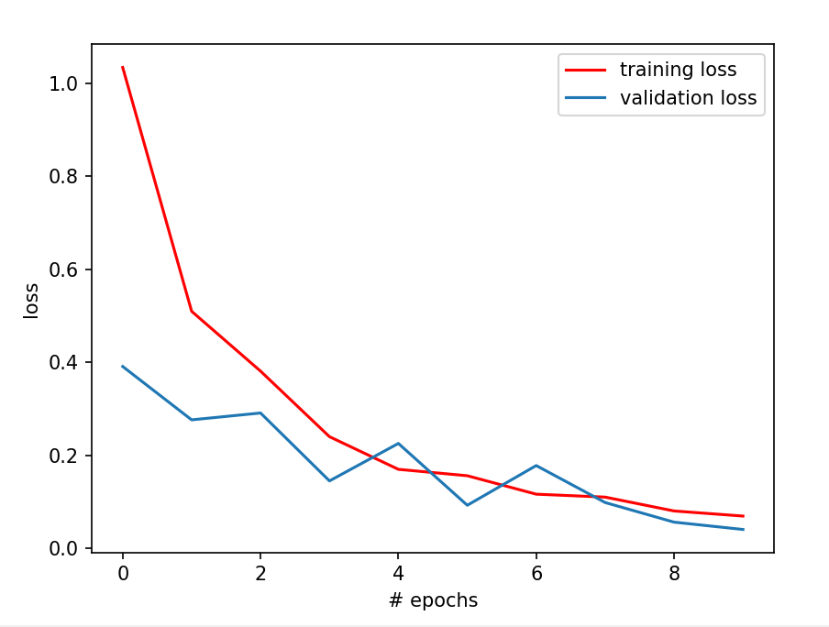
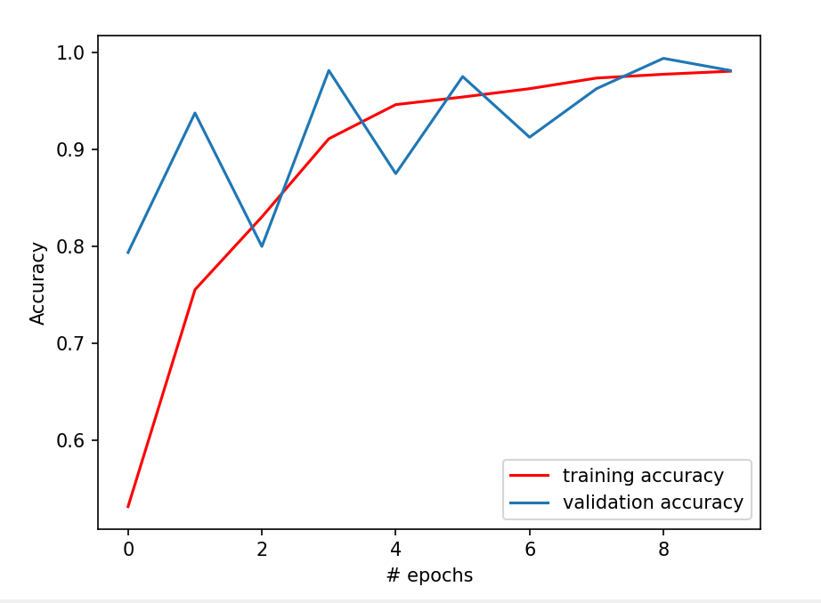
Results and Discussion
Notes:
Provide summary of Phase – 1.
Include the suggestions and improvements made.

Slide 11
Results and Discussion
The accuracy for training data is: 0.9773
The loss for Training data is: 0.0804
The accuracy for validation data is: : 0.9937
The loss for validation data is: 0.0564
The accuracy for test data is: 93.87755393981934
The loss for test data is: 0.49356546998023987
Drawbacks
Not able to differentiate between real human face and pic image(no liveliness)
Notes:
Provide summary of Phase – 1.
Include the suggestions and improvements made.

Slide 12
References
Python | Data Augmentation – GeeksforGeeks
Face Detection with Haar Cascade. Exploring a bit older algorithm which… | by Girija Shankar Behera | Towards Data Science
OS Module in Python with Examples – GeeksforGeeks
Keras API reference\\
Image Processing Tutorial Using Python | Python OpenCV Tutorial | Python Training | Edureka – YouTube
LEARN OPENCV in 3 HOURS with Python | Including 3xProjects | Computer Vision – YouTube
OpenCV Haar Cascades - PyImageSearch
Notes:
Provide summary of Phase – 1.
Include the suggestions and improvements made.

Slide 13
Thank You

